Slide 1
Distant Philosophizing
Applying computational literary studies to philosophical issues

Slide 2
Contents
Context
Development
Results
Conclusions

Slide 3
1) Context
Plato’s footnote
Philosophy is renowned to have raised conceptual issues for centuries. The philosophical tradition includes thousands of authors and intellectuals that started to question and analyze in depth the very essence of reality since the VI Century BC. Despite being an old tradition, many (if not all) philosophical problems are yet unsolved and still debated in today’s academical classes.
A common question for scholars that are interested in the evolution of philosophical thought is to understand whether the subject has undergone a proper development throughout the centuries or not. In other words, they are interested in knowing if the philosophical problems (and eventual solutions) that were firstly raised by ancient philosophers are the same that we are discussing nowadays.
Alfred North Whitehead notoriously claimed that we could reduce all the western philosophy to the problems that were raised by Plato i.e. that in his writing there already were all the possible ideas that we could conceptualize about things like Truth, Beauty, Nature, the human Soul and so on.
Is this really the case?

Slide 4
1) Context
Plato’s footnote
This sort of problem has been a serious issue for most of the western history of philosophy. Most scholars would agree that contemporary philosophy is more than just a mere extension of Greek philosophy. They would argue that some of the issue raised by Plato and his fellows are still worth to discuss, but the evolution of human culture has brought completely new problems to deal with and new ways of solving them.
However, it is not always that easy to state why and in which sense philosophy has changed. Are new concepts forged throughout the centuries? Are philosophers using different words to deal with the same problems? Can we track patterns in how problems have been tackled in different eras and/or different cultures?
These kind of questions look promising to be faced with computational tools that can analyze the use of terms and search for linguistic patterns. Can we use Distant Reading to analyze the evolution of philosophical thought during the two thousand years of intellectual activity?

Slide 5
1) Context
What is Distant Reading?
The basic idea behind Distant Reading is exploiting computational tools and quantitative methods to perform analysis of literary texts. It focuses on analyzing big sets of literary texts in order to discover new interesting cultural patterns and explain macro-phenomena that could not be described without looking at the big picture.
Contrary to Close Reading i.e. a deep analysis of the text performed by reading it in depth, Distant Reading allows to gain actual evidence to prove or confute research hypothesis. It is a very useful methodology that can be implemented by scholars to deal with old critical problems in a new way and hopefully learn important lessons about them.
«Distant reading: where distance, let me repeat it, is a condition of knowledge: it allows you to focus on units that are much smaller or much larger than the text: devices, themes, tropes— or genres and systems. And if, between the very small and the very large, the text itself disappears, well, it is one of those cases when one can justifiably say, Less is more» (Franco Moretti)

Slide 6
1) Context
Why Distant Philosophizing?
Because we want empirical evidence to prove whether our research hypothesis are consistent or not
Because we might be able to explain some cultural and societal phenomena with the aforementioned evidence
Because we could extend our studies to less known authors (e.g. non-western philosophy) that are usually ignored by most historiography
Because when it come to philosophical essays, Close Reading may be incredibly boring

Slide 7
2) Development
Philosophical interlude
When we refer to the problem of knowledge in philosophy we are posing the following questions: what does it mean that we know something? What are the conceptual features that distinguish a mere opinion about a fact from proper knowledge about it? What kind of processes are in play when we know something?
As it is often the case the problem was raised by Plato in a work called Theaetetus. The most naïve answer would claim that we know something when we have experience of it. But if we analyze the issue more in depth, as Plato usually does, we immediately understand that there are may situations in which this simple solution cannot hold. In fact, contemporary philosophy (especially from analytics) is still debating this very issue.
Philosophers care about knowledge for a wide range of reasons, the most important being the fact that only by understanding knowledge we can confute the skeptic hypothesis that we do not know anything about the external world and we just live in a sort of simulation. But the issue is also very important for more down to earth problems: we tend to believe that modern science is able to grasp the authentic meaning of nature; but how can we make such claims if we do not understand what “knowing” is?

Slide 8
2) Development
The Project in brief
The main goal of this project is to perform quantitative analysis of philosophical works in order to find evidence that supports or reject scholar hypothesis like the one mentioned at the beginning. The underlying idea is that we can see how philosophers have dealt with a specific problem analyzing word patterns in their own works.
The set of works that has been selected range from the most ancient philosophical essays, i.e. Plato’s works to contemporary books of epistemology. For this project I specifically selected works that deal with the problem of knowledge, commonly referred to as gnoseology or, in modern terms, epistemology (Filosofia della conoscenza, rather different from Italian Epistemologia).
To perform all the analysis I implemented a Python script with some functions that are able to analyze textual data. The dataset include works by Plato, Aristotle, Descartes, Hume, Kant, Timothy Williamson, Ernest Sosa and Richard Feldman for a total of 16 texts. The size of the corpus is sufficient for the aims of this project, but it can (and it should) be extended to proper implement such methodology.

Slide 9
2) Development
Project goals and limitations
Analyze different philosophical works from different eras that deal with a specific issue
Words are just a proxy for philosophical problems: results might not be completely relevant for the research case
This is a very limited corpus: an efficient implementation would required a large amount of texts
All works are English translations. Particularly problematic for ancient texts

Slide 10
2) Development
Steps
Gather the textual data (16 files)
Group them by historical era
Take a look at the data (raw frequencies and TF-IDF)
Perform topic modelling

Slide 11
2) Development
Tools implemented in Python
Pandas for organizing and display the data
Nltk for pre-processing cleaning the dataset and retrieve textual features
Gensim (based on sklearn) to perform topic modeling
LDAvis to visualize the results
cf. the Colab file

Slide 12
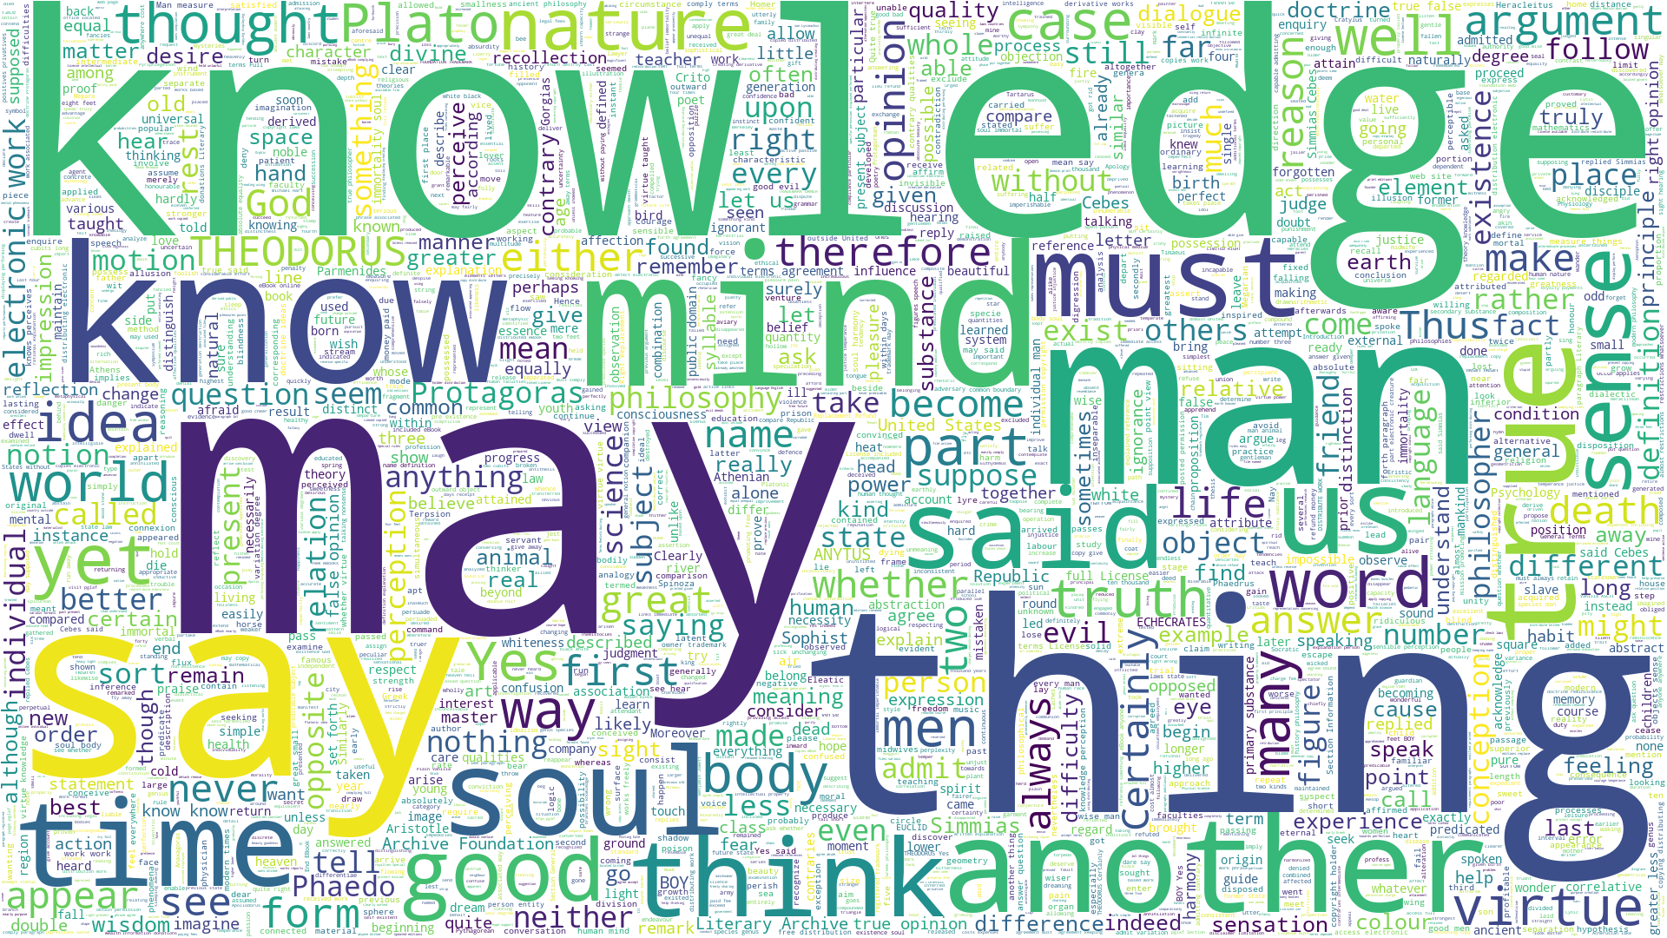
3) Results
A first look at the data
Ancient philosophy

Slide 13
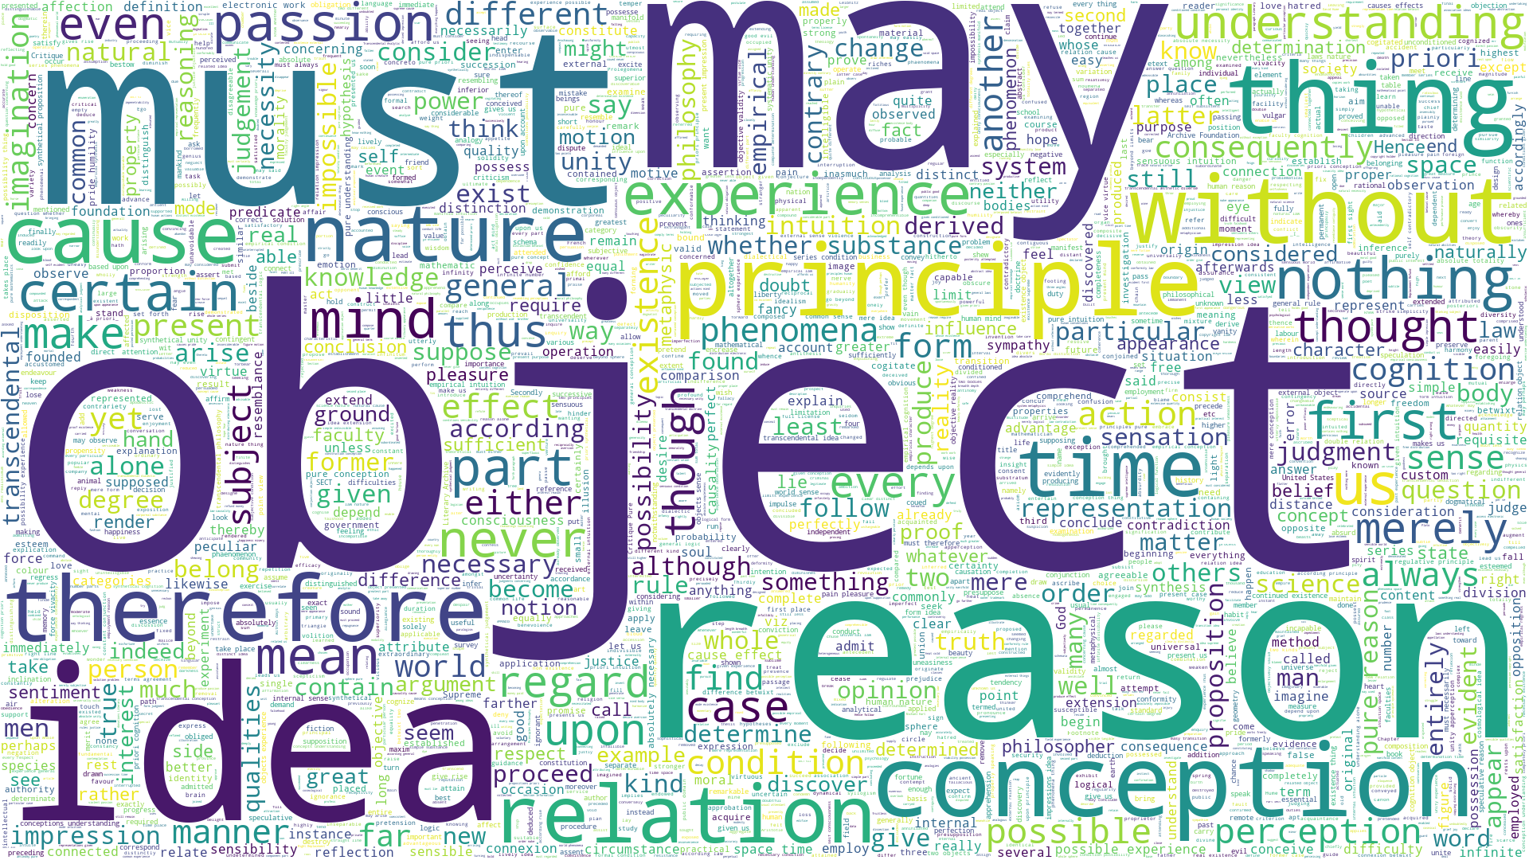
3) Results
A first look at the data
Modern philosophy

Slide 14
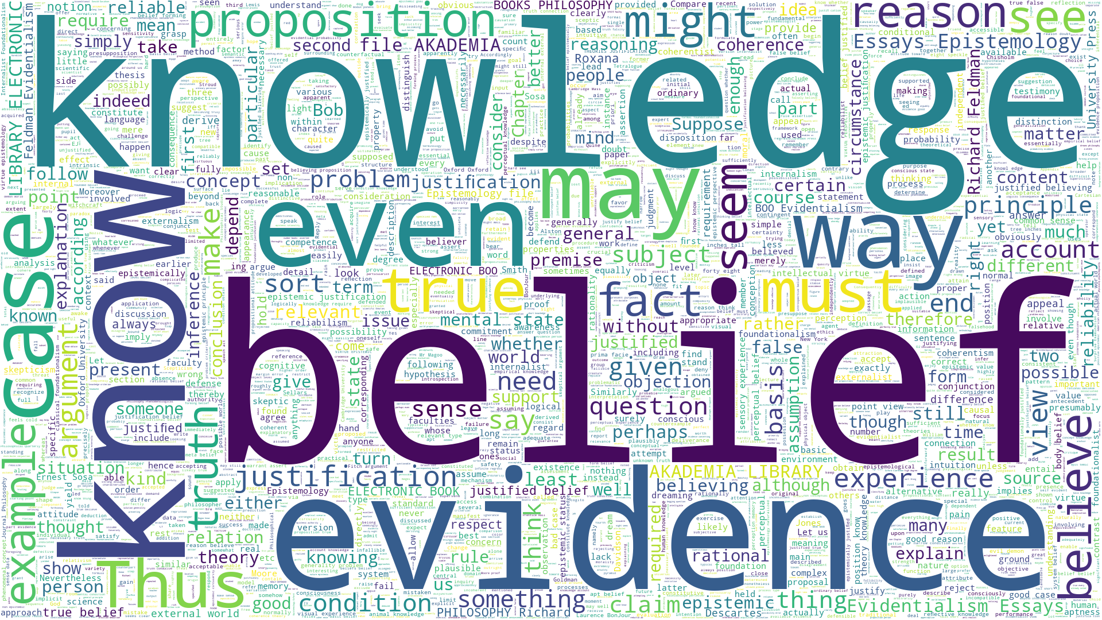
3) Results
A first look at the data
Contemporary philosophy

Slide 15
3) Results
Raw frequencies (per author)
Plato | Aristotle | Descartes | Hume | Kant | Sosa | Williamson | Feldman
('may', 557) | ('man', 104) | ('may', 254) | ('may', 1188) | ('reason', 1427) | ('belief', 2157) | ('know', 1026) | ('evidence', 1229)
('knowledge', 458) | ('case', 74) | ('things', 218) | ('us', 932) | ('experience', 1207) | ('knowledge', 1903) | ('evidence', 1025) | ('belief', 1093)
('would', 391) | ('said', 73) | ('us', 185) | ('idea', 803) | ('must', 1065) | ('beliefs', 1796) | ('knowledge', 955) | ('beliefs', 787)
('say', 382) | ('contrary', 72) | ('body', 156) | ('must', 789) | ('conception', 938) | ('would', 1449) | ('true', 709) | ('justified', 687)
('man', 372) | ('also', 63) | ('God', 141) | ('object', 684) | ('understanding', 863) | ('epistemic', 1154) | ('case', 619) | ('justification', 650)
('know', 346) | ('subject', 61) | ('also', 127) | ('objects', 651) | ('pure', 859) | ('justiﬁcation', 892) | ('knows', 537) | ('epistemic', 624)
('mind', 345) | ('present', 57) | ('certain', 123) | ('ideas', 602) | ('object', 838) | ('even', 860) | ('would', 536) | ('Epistemology', 566)
('true', 326) | ('substance', 56) | ('without', 120) | ('mind', 590) | ('time', 836) | ('may', 848) | ('belief', 489) | ('knowledge', 554)
('us', 324) | ('species', 54) | ('self', 115) | ('upon', 553) | ('may', 784) | ('must', 827) | ('mental', 456) | ('Evidentialism', 540)
('soul', 322) | ('may', 53) | ('mind', 109) | ('without', 471) | ('possible', 774) | ('true', 814) | ('2', 439) | ('Essays', 526)

Slide 16
2) Development
TF-IDF
The previous table shows us some interesting results just considering the raw frequencies of most common words (stopwords were already removed with nltk). However, raw frequency can be misleading, thus it we should consider getting the TF-IDF scores for each author.
TF = Term Frequency i.e. the number of occurrences of a specific word in the whole corpus.
IDF = Inverse Document Frequency i.e. the inverse number of documents in which the word appears
TF-IDF= the product between TF and IDF, which basically weights each terms for their relevance i.e. it increases if the word is more frequent in a document and that word is rather rare in the rest of the corpus

Slide 17
3) Results
TF-IDF scores (per author)
Plato | Aristotle | Descartes | Hume | Kant | Sosa | Williamson | Feldman
('boy', 161.593) | ('contraries', 61.924) | ('bloud', 95.155) | ('passions', 685.924) | ('empirical', 1082.871) | ('beliefs', 2552.325) | ('witchcraft', 365.595) | ('evidentialism', 1343.112)
('friend', 104.004) | ('genus', 57.16) | ('onely', 92.651) | ('passion', 585.893) | ('cognition', 1032.061) | ('justiﬁcation', 2318.776) | ('conjunction', 258.606) | ('epistemic', 1269.462)
('harmony', 99.788) | ('predicable', 44.071) | ('divers', 76.059) | ('betwixt', 546.901) | ('transcendental', 927.267) | ('epistemic', 2279.961) | ('beliefs', 224.874) | ('akademia', 1257.047)
('wisdom', 99.788) | ('privatives', 32.553) | ('nerves', 72.437) | ('imagination', 532.671) | ('synthetical', 633.781) | ('justiﬁed', 1560.04) | ('entails', 215.501) | ('justification', 1184.489)
('replied', 96.855) | ('correlatives', 30.049) | ('beleeve', 70.114) | ('hatred', 418.181) | ('sensuous', 579.217) | ('justification', 1176.55) | ('tetralogue', 187.806) | ('beliefs', 1132.805)
('immortality', 85.74) | ('positives', 27.282) | ('hath', 57.95) | ('pride', 347.15) | ('synthesis', 468.397) | ('epistemology', 921.763) | ('evidential', 186.526) | ('epistemology', 1110.1)
('dialogue', 83.303) | ('similarly', 26.704) | ('etext', 56.139) | ('humility', 257.221) | ('sensibility', 379.849) | ('foundationalism', 898.221) | ('relevant', 172.038) | ('justified', 988.042)
('republic', 80.977) | ('relatives', 25.183) | ('minde', 52.586) | ('sentiments', 252.458) | ('judgement', 342.962) | ('justified', 757.546) | ('fitch', 167.773) | ('essays', 743.491)
('divine', 77.301) | ('differentiae', 25.041) | ('therein', 49.221) | ('sympathy', 242.931) | ('unconditioned', 330.538) | ('relevant', 673.666) | ('counterfactual', 166.606) | ('smith', 487.14)
('crito', 67.156) | ('correlative', 22.229) | ('corporeal', 47.634) | ('esteem', 239.242) | ('cognitions', 312.693) | ('perceptual', 603.04) | ('factive', 165.79) | ('251', 472.653)

Slide 18
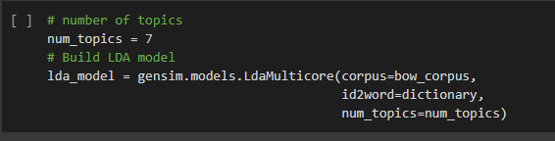
3) Results
Topic Modelling
Topic modelling is an algorithmic technique that tries to subdivide words in a text (or a corpus) into clusters that are somehow semantically meaningful. The underlying assumption is that words that usually come together are associated with a specific topic. Thus, a topic is nothing but a list of words that capture a specific meaning (presumably) wanted by the author.
Gensim basically transforms the documents in the corpus into vectors and exploit various algorithm to perform topic modelling. For sake of simplicity, in the current project LDA (Latent Dirichlet Analysis) was implemented without any changes to the basic settings. LDA is a popular method for topic modelling which considers each document as a collection of topics in a certain proportion.
Usually topic modelling is implemented to have a general understating of the meaning of a large corpus of texts. However, here topic modelling was applied with a different scope. We already know the general topic that we are dealing with and we want to see whether we can recognize a variation in the semantic clusters when we divide the whole corpus into philosophical subsections.

Slide 19
3) Results
Topic Modelling
Analyzing topic modelling results is usually a very difficult task. LDAvis allows to easily interpret Gensim output by providing a visualization tool with which users can immediately see the semantic meaning of each topic. Selecting a topic on the left allows to visualize the most useful terms for that topic, along with a global rank of the most relevant words; selecting a word reveals the conditional distribution over topics of the selected term.
The Lambda value determines the weight given to the probability of term w under topic k relative to its lift (measuring both on the log scale).
Authors suggest to keep the Lambda value at 0.6, because setting it to 1 mean that terms are ranked solely by Phi value, which implies plies the red bars would be sorted from widest (at the top) to narrowest (at the bottom)
The area of the circles are proportional to the relative prevalences of the topics in the corpus, while the distance between the centre of each circle represents how much two topic diverge from each other .

Slide 20
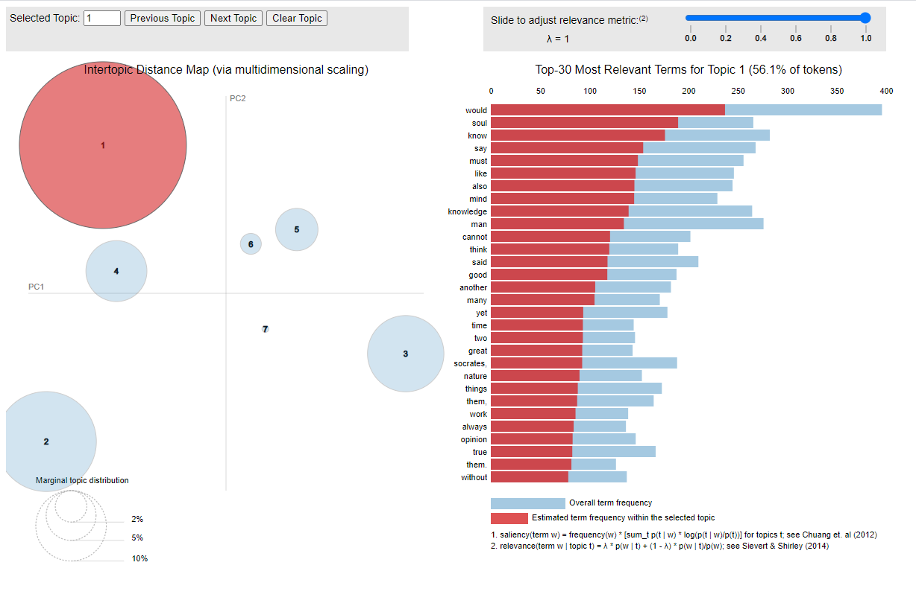
3) Results
Topic modelling for ancient philosophy

Slide 21
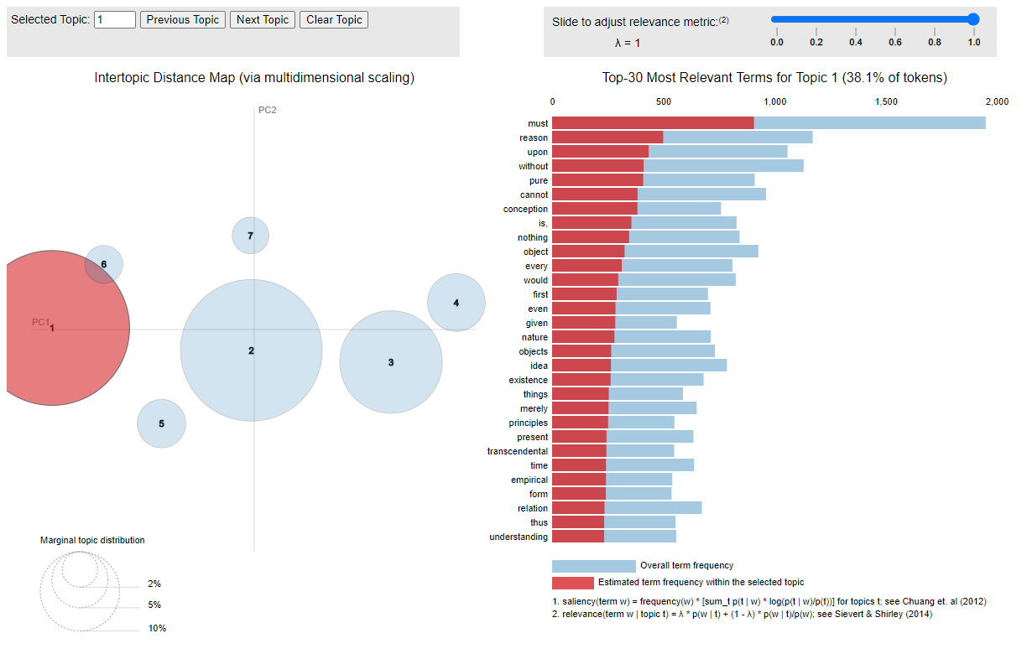
3) Results
Topic modelling for modern philosophy

Slide 22
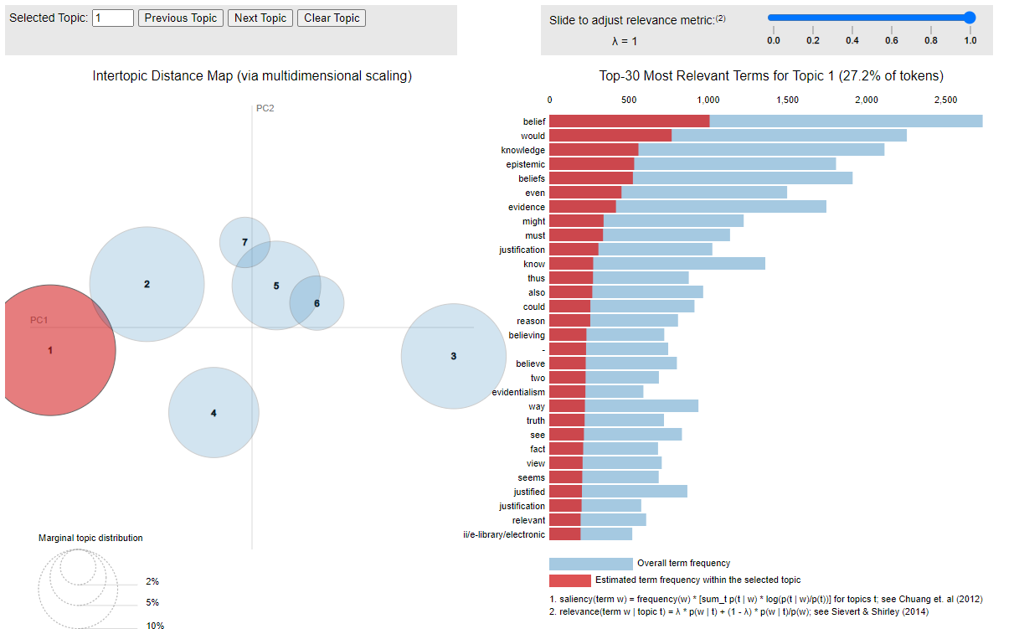
3) Results
Topic modelling for contemporary philosophy

Slide 23
4) Conclusions
Conclusions and further developments
The results shows us that there are some important differences in the way in which ancient and contemporary philosophers deal with philosophical issues. If we look closer at the topic that were selected by the algorithm, we can claim that the set of words that are clustered as topic have different meanings and a lot of potential implications.
However, one could ask: did we really learn something new? In fact, most scholars would agree that contemporary epistemology is a rather different subject then ancient gnoseology. We already know that justification, belief and evidence are modern terms employed in the debate. The results are coherent with what we already know from historiographic research, but they do not look groundbreaking at all.
So do we need distant philosophizing?

Slide 24
4) Conclusions
Conclusions and further developments
Here we are using a toy example, with a limited corpus and a very specific subject. Most philosophical issues do not have such clear boundaries and thus an explorational work on the semantic could be rather interesting for scholars before actually going in depth on the matter.
Although familiar with western philosophy, many historians of philosophy field tend to ignore other philosophical movements. Computational tools could help us in searching for correlations between similar philosophical issues tacked by very distant authors (e.g. Chinese or Muslim ones). It may be interesting to see whether such problems were also tackled in different eras and cultures, and if so in which way. Close Reading could be an option, as it was since for ever, but Distant Reading can save us important time and help us finding a good lead.
Moreover, now we have empirical evidence that there is a clear difference in the way in which authors have been tackled the problem of knowledge. Analytical philosophers would claim that we have finally gained enough evidence to justify our belief about the history of the problem of knowledge.

Slide 25
4) Conclusions
Sources
Shashank Kapadia, Topic Modeling in Python: Latent Dirichlet Allocation (LDA): How to get started with topic modeling using LDA in Python
Shawn Graham, Scott Weingart, and Ian Milligan, Getting Started with Topic Modeling and MALLET
Matthew J. Lavin, Analyzing Documents with TF-IDF
Code and textual sources at the Github repository
C. Sievert and K. E. Shirley, LDAvis: A method for visualizing and interpreting topics, 2014.
Ted Underwood, Distant Horizons: Digital Evidence and Literary Change, University of Chicago Press, 2019.

